Slide 1
PPE DETECTION
Group members:
1)Sakshi Chavhan
2)Anushka Jadhav
3)Nandini gangurde
4)Jayesh Bhise

Slide 2
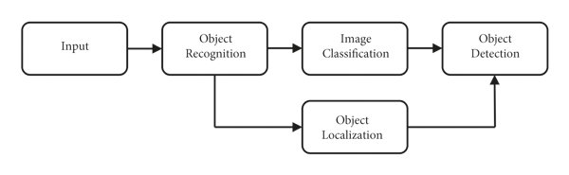
Object Detection Algorithms

Slide 3
Type of object detection
1)Region Proposal based frameworks:
It is composed of 3 correlated stage , Including region proposal generation, feature extraction with CNN, classification and bounding box regression,whih are usually trained seperately
2)Regression/Classification Based Framework:
One step frameworks based on global regression/classification, mapping straightly from pixel tobounding box co-ordinates and class probabilities, can reduce time expense
e.g: YOLO,SSD(single shot multibox detector)

Slide 4
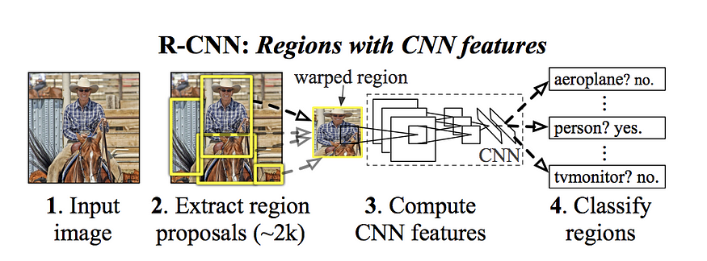
R-CNN
R-CNN was one of the early methods for object detection.
First, it generates a set of region proposals (potential bounding boxes) using a selective search algorithm. Then, it applies a convolutional neural network (CNN) to each proposed region to classify and refine the bounding box.
Drawback: R-CNN is slow due to the two-stage process, making it impractical for real-time applications.

Slide 5
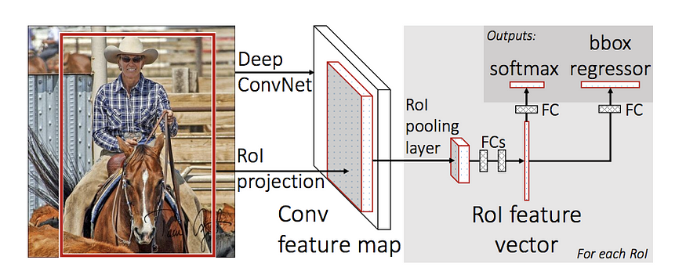
Fast R-CNN
Fast R-CNN combines region proposal generation and classification into a single network. It uses a region of interest (RoI) pooling layer to extract fixed-size features from the CNN

Slide 6
Faster R-CNN
Introduces an additional neural network, the Region Proposal Network, to predict region proposals instead of relying on external methods like selective search.
Advantage: Significantly faster than both R-CNN and Fast R-CNN.
YOLO
Single-shot detection: YOLO divides the input image into a grid and predicts bounding boxes and class probabilities directly within each grid cell. It eliminates the need for separate region proposal networks.
Advantage: YOLO is known for its speed and efficiency, as it processes the entire image in a single forward pass.

Slide 7
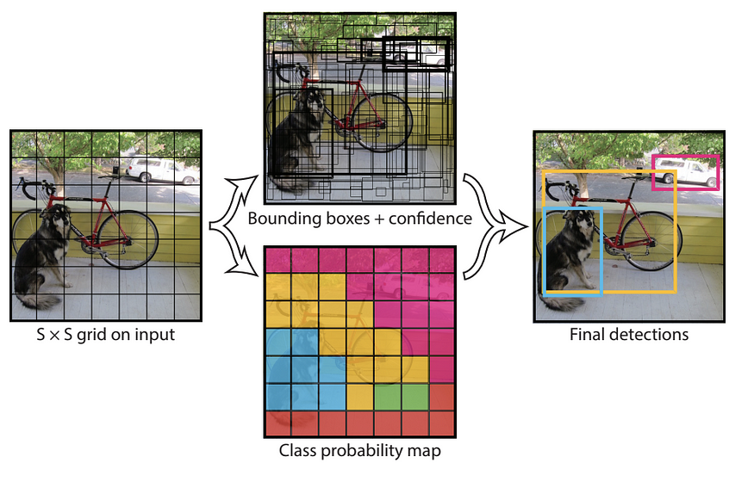

Slide 8
Dataset
1759- Total Images
Classes:
Gloves, Hardhat,, Mask, NO-Hardhat, NO-Mask, NO-Safety Vest, Person, SUV, Safety Cone, Safety Vest, bus, dump truck, fire hydrant, machinery, mini-van, sedan, semi, trailer, truck, truck and trailer, van, vehicle,

